Slide 1
INFO-H-503 CUDA GPGPU programming
≥ CUDA 6.0
Slides 01
TA: Daniele Bonatto
Teacher: Gauthier Lafruit

Slide 2
Acknowledgment
Those slides are partially based on:
9th Intl. Conference on Articulated Motion and Deformable Objects (AMDO'16) at Palma de Mallorca (Spain) by Manuel Ujaldón
http://amdo2016.uib.es/wp-content/uploads/2016/07/CUDA-Tutorial.pdf
Programming Massively Parallel Processors, Third Edition: A Hands-on Approach 3rd Edition by David B. Kirk,Wen-mei W. Hwu
CUDA by Example: An Introduction to General-Purpose GPU Programming 1st Edition by Jason Sanders, Edward Kandrot
Professional CUDA C Programming 1st Edition by John Cheng, Max Grossman , Ty McKercher
https://llpanorama.wordpress.com/2008/06/11/threads-and-blocks-and-grids-oh-my/
https://www.pelagos-consulting.com/?p=503
CUDA Programming – A Developer’s Guide to Parallel Computing with GPUs – Shane Cook
https://www.slideshare.net/npinto/harvard-cs264-05-advancedlevel-cuda-programming
CSC 391/691 : GPU Programming – Fall 2011 – CUDA Thread Basics, Samuel S. Cho.
https://www.youtube.com/watch?v=CZgM3DEBplE – CUDA Tutorial 9 Bank Conflicts
CUDA Threads and Atomics - CME343 / ME339 - 25 April 2011, James Balfour

Slide 3
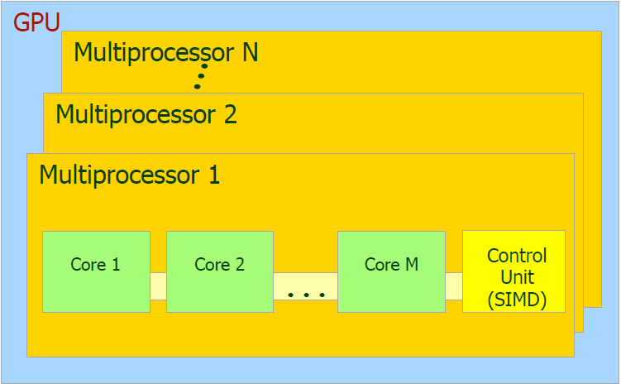
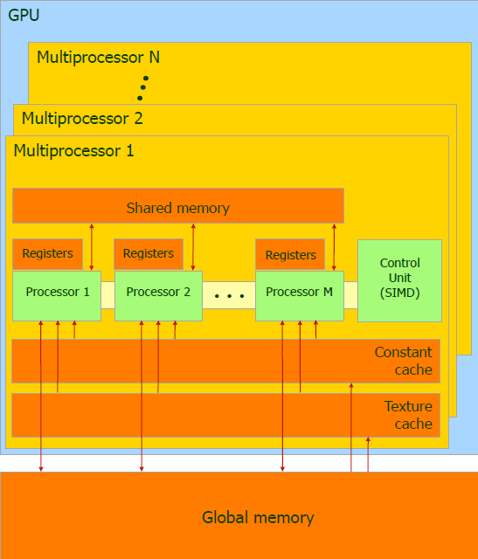
What is a GPU
A GPU consist of N Multiprocessors
Each containing M Stream Processors (SM)
Each containing K cores
GM2000 (Maxwell)
2015
4 to 24 SMs
128 cores/SM
Total number of cores: 512 to 3012
We also have a memory hierarchy
Video memory (GDDR5), faster than DDR3
Each multiprocessor has :
a register file Very fast, each core in a SM has several registers.
shared memory, 500 x faster than the video memory. This memory is shared between all the cores in a SM.
constant cache and a texture cache (fast but READ ONLY) This memory is shared between all the cores in a SM.

Slide 4
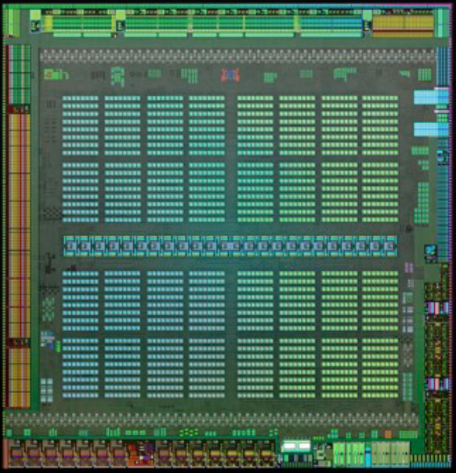
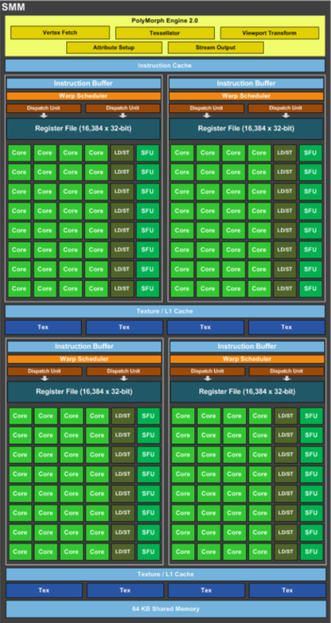
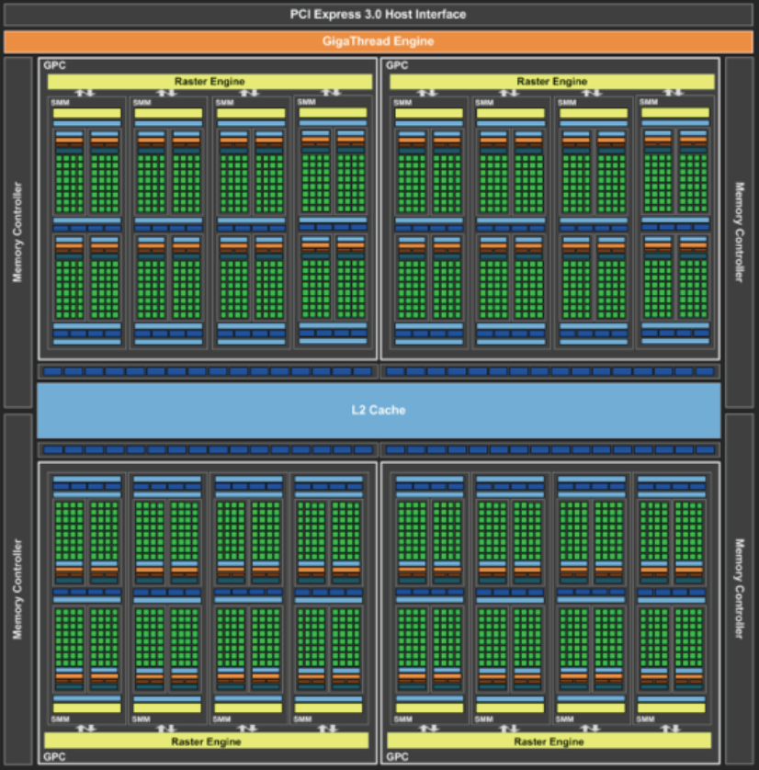
GTX 980 (Maxwell)
Multiprocessor
16 Multiprocessors
4 SM (Streaming processor)
32 Cores per SM
16 x 4 x 32 = 2048 cores!
Block Memory
Streaming
Multiprocessor
(SM)
1 core = 1 thread + local memory
Shared memory

Slide 5
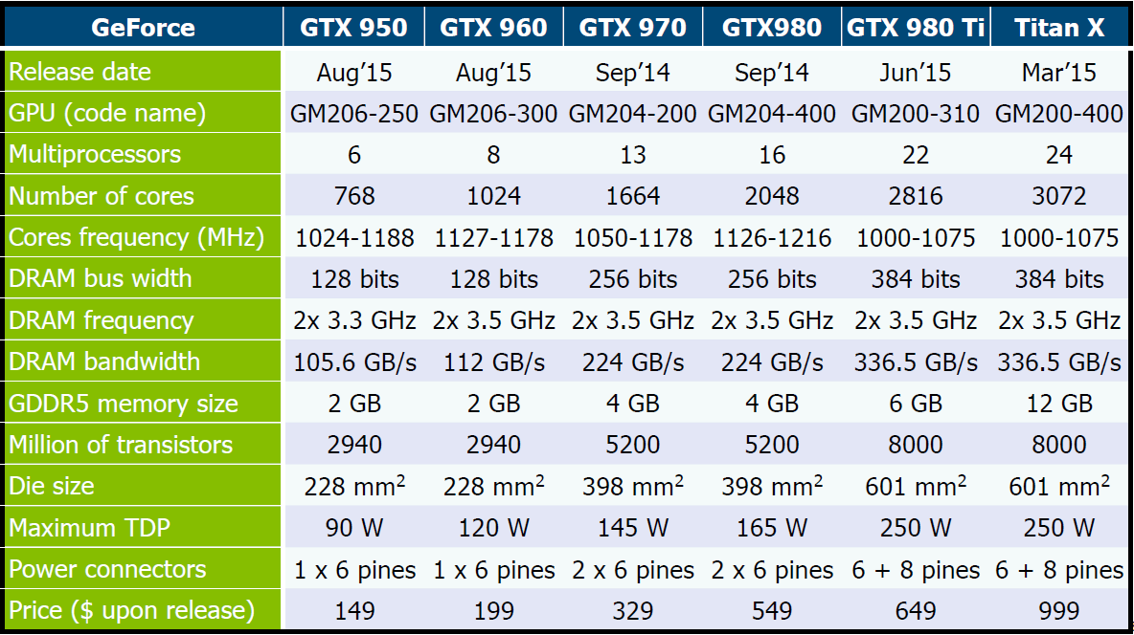
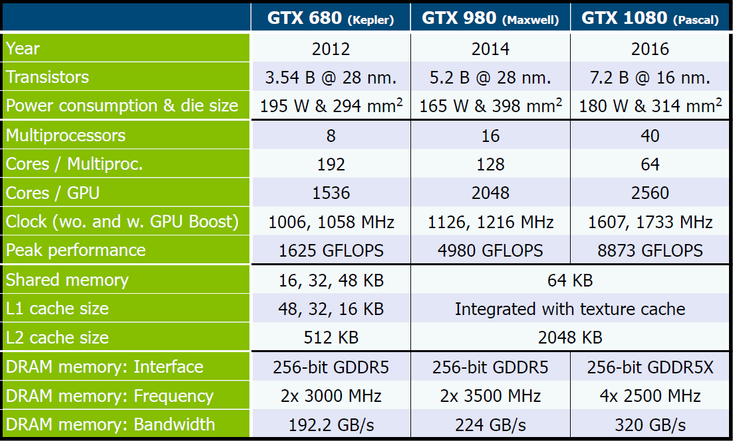
Commercial models caracteristics (28nm)
For now, it is often better to have 980 Ti or Titan X than a GTX 1080 in term of computing cores. However, the frequencies are not the same

Slide 6
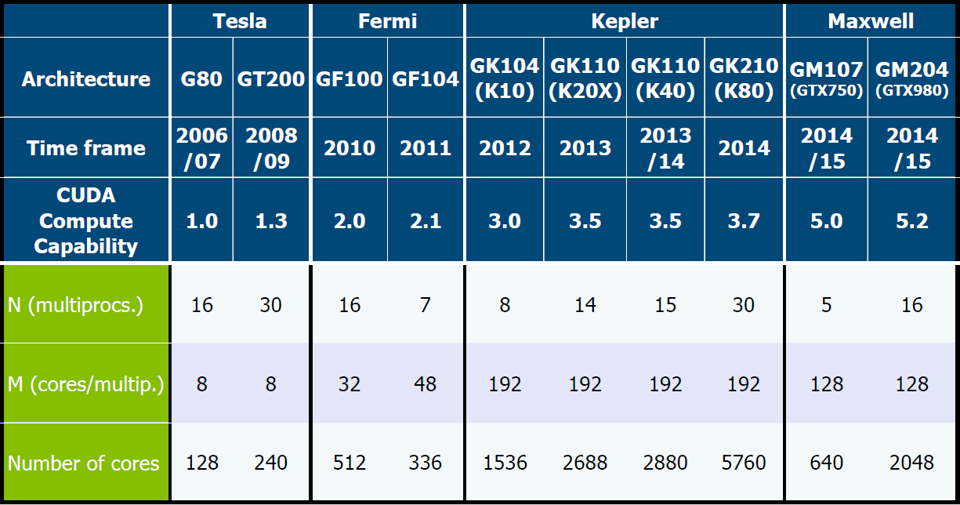
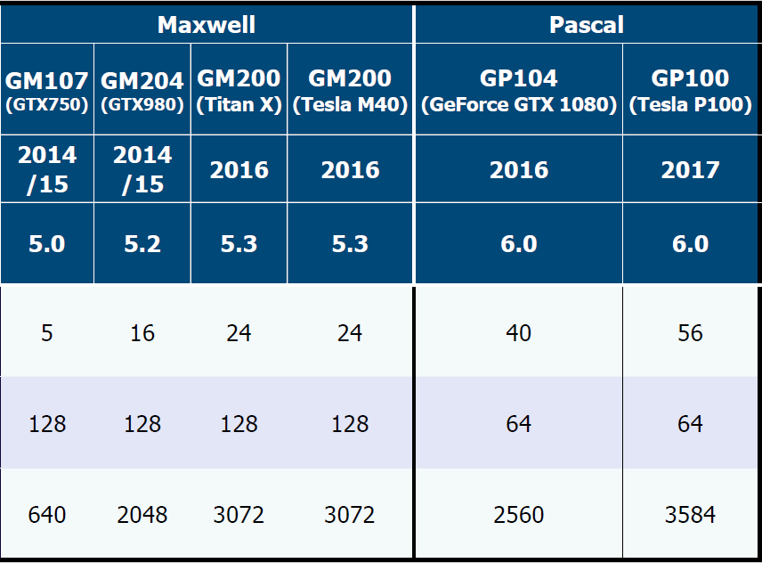
In the past

Slide 7
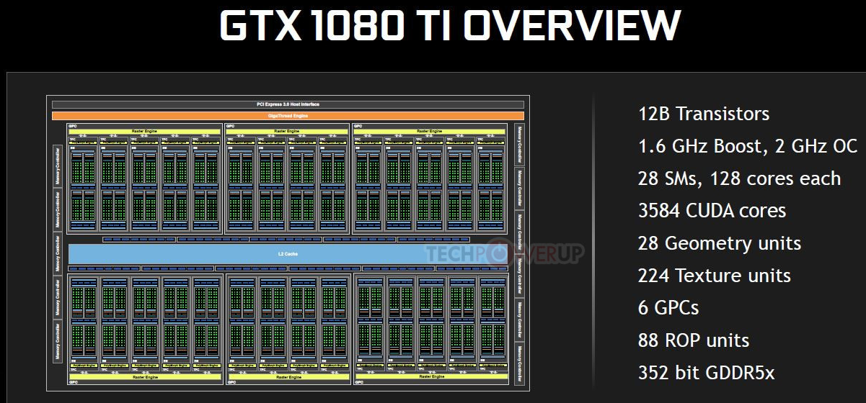

Slide 8
Terminology
Host: The CPU and the main memory [DDR3/4/…]
Device: The graphics card [set of multiprocessors + video memory (GDDR5/…) ]
Multiprocessor: Set of processors + shared memory
Kernel: Steps that are run in sequence on the GPU ~function
Stream: Queue of kernels that the hardware will schedule sequentially.
SP – Symmetrical processor : Computational cores
SM – Streaming machine – Can be thought of as single processor with N cores (SPs) embedded within it.
Thread: An execution of a kernel with a given index. Each thread uses its index to access elements in arrays.
Block: Group of threads, executed concurrently or serially and in no particular order (sync with _syncthreads(), wait all threads in the same block)
The threads in a block can communicate with shared memory.
Grid: Group of blocks. On synchronization at all between the blocks.
Warp size: 32. The threads in a block are organized in warps. This is the granularity of the scheduler for issuing threads to the execution units

Slide 9
From kernel to the execution
Every kernel (program for the GPU) is ultimately executed on streaming multiprocessors (SMs).
When a kernel is invoked, we specify how many threads we want to launch in a block and how many blocks we want to launch in the grid
These blocks gets ultimately mapped to one of the available SM’s to execute
All the threads in a block can share the memory on the SM as they are on the same SM.
Now, we have blocks which execute on SM:
SM won’t directly give the threads the execution resources.
It will try to divide the threads in the block into warps (32 threads)
The warps in each of the blocks exhibit SIMD execution (Single Instruction Multiple Data)
If there is a memory access to any thread in a warp, SM switches to next warp. This way, SM always have some work to do
https://www.quora.com/What-is-a-warp-and-how-is-it-different-from-a-thread-block-or-wave-in-CUDA

Slide 10
Grid? Blocks? Threads? Warps??
A grid is composed of totally independent blocks
A block is composed of threads which can communicate within their block
The threads can be paused and resumed at will
32 threads form a warp and the CUDA instructions are done in warp.
Thus:
Each warp threads execute parallelly and share the same code:
Follow the same execution path with minimal divergence
Is expected to stall at the same places
If a warp stall for any reason (typically operand not ready), we have a context switch and another warp will be executed
We pause all the threads in a warp and resume them at the same time due to the previous assumptions
REMARK: If the warp have divergences and/or stall in different places, we are going to have an underutilization of the hardware resources -> TRY TO AVOID IFs INSTRUCTIONS
REMARK: A warp is a scheduling unit for the SM
REMARK: CUDA works in SIMT Single Instruction Multiple Threads
https://www.quora.com/What-is-a-warp-and-how-is-it-different-from-a-thread-block-or-wave-in-CUDA

Slide 11
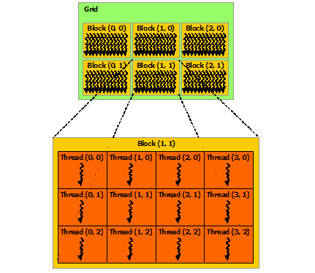
How CUDA splits problems
Grids of blocks of threads
The blocks runs in any order
The blocks are run on one SM with free slots
A Warp is a set of 32 threads in a block that execute the same kernel at the same time
Military analogy:
Army (grid) of soldiers (threads). The army is split into a number of units (blocks), each commanded by a lieutenant. The unit is split into squads of 32 soldiers (a warp), each commanded by a sergeant
To perform some action, central command (kernel/host) must provide some action plus some data. Each soldier (thread) works on his or her individual part of the problem. Threads may from time to time swap data with one another under the coordination of either the sergeant (warp) or the lieutenant (block). However, any coordination with other units (blocks) has to be performed by central command (kernel/host)

Slide 12
CPU vs GPU threading
In the CPU, threads are lighter than process but they remain slow
This is due to:
Their spawning and,
context switching.
In the GPU the threads are extremely lightweight
Almost no overhead
Context switching is virtually free
Thus in the GPU we want to make as much threads as we can
Each SM process batches of blocks one after another.

Slide 13
Playing with parallel constraints on Maxwell to maximize concurrency
We have hardware and software limits when we use a GPU
By asking the card we can see that the limits within a SM in a Maxwell GPU are:
32 concurrent blocks (blocks/SM in the doc)
1024 threads/block (in the doc)
2048 threads total (threads/SM in the doc)
1 block of 2048 threads. [2] (not feasible)
2 blocks of 1024 threads. Feasible on the same SM
4 blocks of 512 threads. Feasible on the same SM
4 blocks of 1024 threads. [3] but feasible involving two SM
256 blocks of 8 threads. [1] but feasible with 8 SM

Slide 14
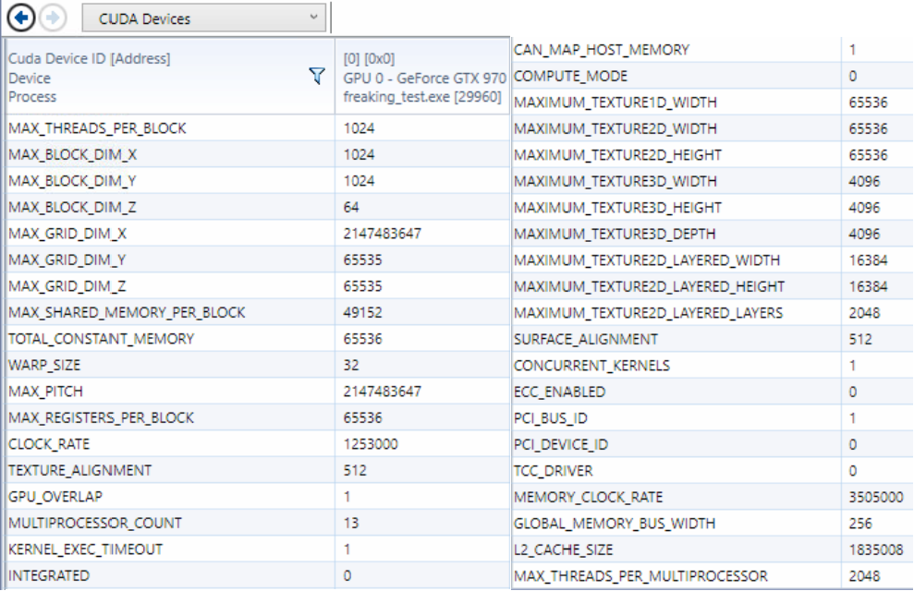
GPU limits
You have to check your GPU limits!
GTX 970

Slide 15
CUDA is almost C
CUDA is very similar to C, we only add some keywords:
Type qualifiers:
__global__ to declare a function to be executed on the GPU
__device__ to declare a function to be called by another function on the GPU
__shared__ to declare shared memory in a kernel
__local__ [see doc]
__constant__ [see doc]
Keywords: threadIdx, blockIdx, gridDim, blockDim to access elements in a kernel
Intrinsics:
__syncthreads(); // to synchronize threads between warps (within a block) and in all the warps (thus all threads..)
atomicAdd(); // to synchronize blocks (see atomic ops: http://docs.nvidia.com/cuda/cuda-c-programming-guide/index.html#atomic-functions )
dim2, dim3, uint2, uint3 // units for cuda : dim2 hello(16,32);
Runtime API: to allocate memory on the GPU and transfer data, check errors, etc.. [doc]
Kernel functions to launch code to the GPU from the CPU: <<<X,Y,Z>>>( . ) (special syntax detailed later)

Slide 16
How to solve a problem on the GPU
Think of a formula that represents each output point as some function of the input data.
For algorithms that have multiple steps: (and are hard to express as a function)
Write several kernels for each step
Usually those are simple kernels
The harder one is the bottleneck which will need some thought
Put those kernels on a queue (Stream)

Slide 17
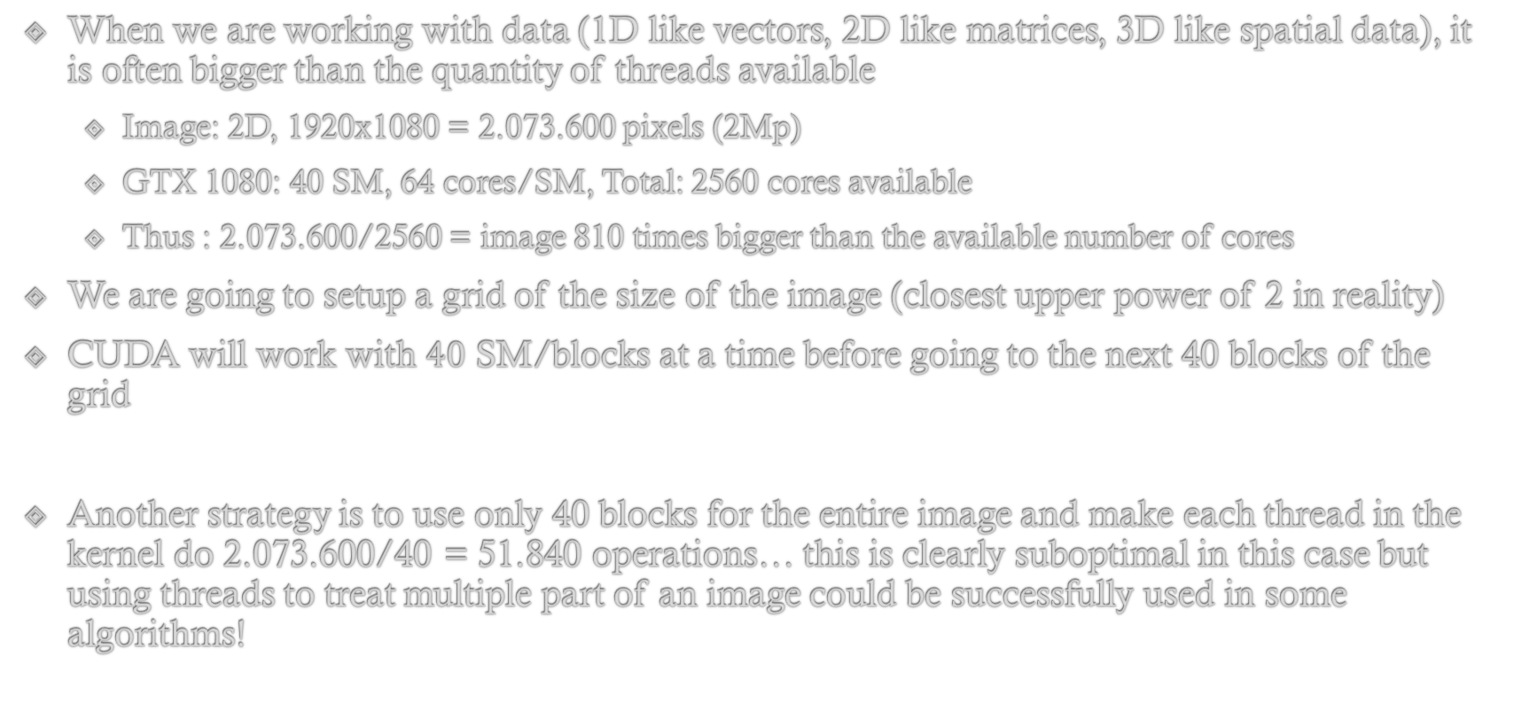
How to divide a problem in CUDA
When we are working with data (1D like vectors, 2D like matrices, 3D like spatial data), it is often bigger than the quantity of threads available
Image: 2D, 1920x1080 = 2.073.600 pixels (2Mp)
GTX 1080: 40 SM, 64 cores/SM, Total: 2560 cores available
Thus : 2.073.600/2560 = image 810 times bigger than the available number of cores
We are going to setup a grid of the size of the image (closest upper power of 2 in reality)
CUDA will work with $40$ SM/blocks at a time before going to the next 40 blocks of the grid
Another strategy is to use only 40 blocks for the entire image and make each thread in the kernel do 2.073.600/40 = 51.840 operations… this is clearly suboptimal in this case but using threads to treat multiple part of an image could be successfully used in some algorithms!

Slide 18


Grid example in 3Ds Max rendering
We can clearly see the blocks working
More cores, less time by Duy Le
https://www.youtube.com/watch?v=MiZDtax_O4U
Rendering Evermotion on 360 cores by MRIYArender
https://www.youtube.com/watch?v=XPXiITMpHGE

Slide 19
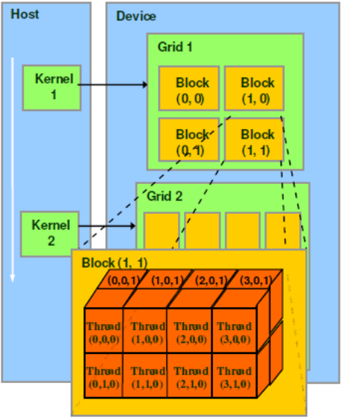
Grid and Blocks dimensions
A lot of problems in science are not expressed in 1D but are rather natural in 2 or 3 dimensions.
Images work well in 2D
Medical scans work well in 3D
CUDA allows the user to make 1D or 2D or 3D grids and 1D or 2D or 3D blocks!
We have special variables in the kernels:
gridDim (How many blocks in the grid)
blockIdx (Index of the working block)
blockDim (How many threads in this block)
threadIdx (local index of the thread within the block)
For all 3 variables, we can acces at least x,y and often z
Eg: blockIdx.x * blockDim.y + threadIdx.z (nonsense here)
REMARK: CUDA WORKS IN COLUMN MAJOR ORDER

Slide 20
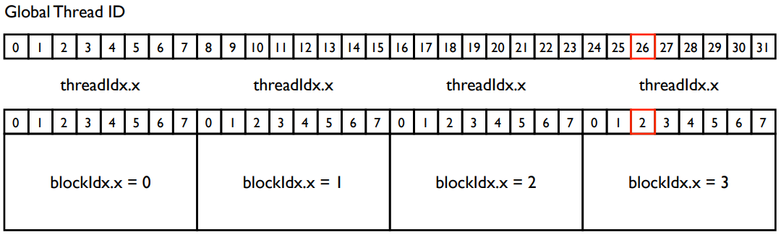
Indexing
CUDA Built-In Variables
blockIdx.{x,y,z} Built-in variables that returns the block ID in the {x,y,z}-axis of the block.
threadIdx.{x,y,z} Built-in variables that return the thread ID in the {x,y,z}-axis of the thread.
blockDim.{x,y,z} Built-in variables that return the block dimension.
The full global thread ID in x dimension can be computed by
x = blockIdx.x * blockDim.x + threadIdx.x;

Slide 21
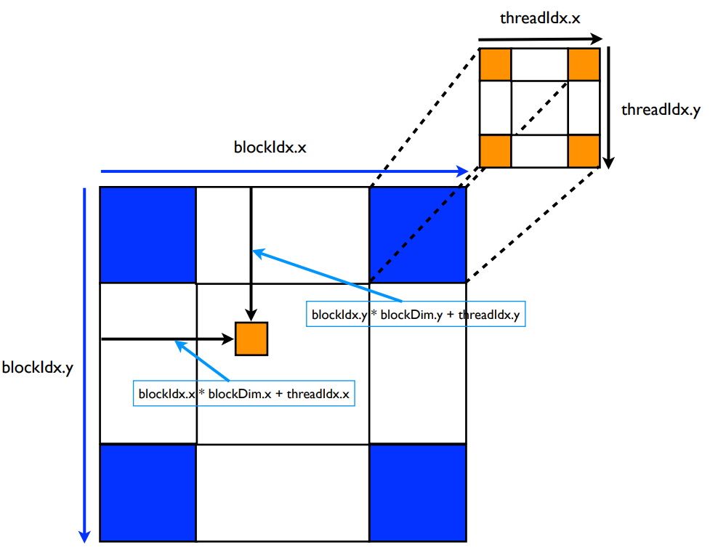
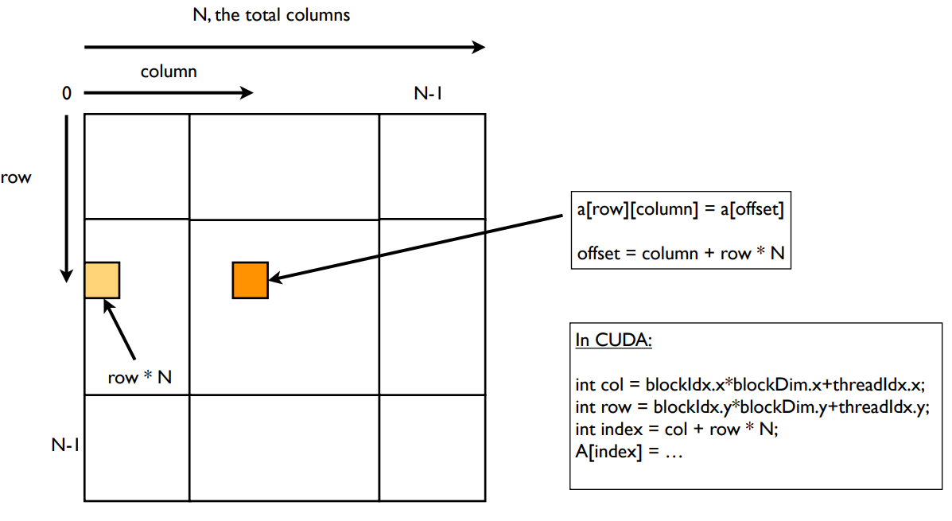
Indexing – Higher dimensions
Number of blocks in 2D grid: gridDim.x * gridDim.y
Number of threads in 3D block: blockDim.x * blockDim.y * blockDim.z
Example of initialization:
dim3 grid(16,16); // grid = 16x16 blocks dim3 block(32,32); // block = 32x32 threads myKernel<<<grid, block>>>(…);
x = blockIdx.x * blockDim.x + threadIdx.x; y = blockIdx.y * blockDim.y + threadIdx.y;

Slide 22
Playing with indexes
THINK BY YOURSELF THERE MAY BE ERRORS THERE: send me a mail ;)
Often we want to find the current thread in absolute position with respect to the blocks and the grid
1D grid of 1D blocks:
threadId = blockIdx.x * blockDim.x
+ threadIdx.x;
1D grid of 2D blocks:
threadId = blockIdx.x * blockDim.x * blockDim.y
+ threadIdx.y * blockDim.x
+ threadIdx.x;
1D grid of 3D blocks:
threadId = blockIdx.x * blockDim.x * blockDim.y * blockDim.z
+ threadIdx.z * blockDim.y * blockDim.x
+ threadIdx.y * blockDim.x
+ threadIdx.x;
2D grid of 1D blocks:
blockId = blockIdx.y * gridDim.x + blockIdx.x;
threadId = blockId * blockDim.x + threadIdx.x;
2D grid of 2D blocks:
blockId = blockIdx.x + blockIdx.y * gridDim.x;
threadId = blockId * (blockDim.x * blockDim.y)
+ (threadIdx.y * blockDim.x)
+ threadIdx.x;
2D grid of 3D blocks:
blockId = blockIdx.x + blockIdx.y * gridDim.x;
threadId = blockId * (blockDim.x * blockDim.y * blockDim.z)
+ (threadIdx.z * (blockDim.x * blockDim.y))
+ (threadIdx.y * blockDim.x)
+ threadIdx.x;
3D grid of 1D blocks:
blockId = blockIdx.x + blockIdx.y * gridDim.x
+ gridDim.x * gridDim.y * blockIdx.z;
threadId = blockId * blockDim.x + threadIdx.x;
3D grid of 2D blocks:
blockId = blockIdx.x + blockIdx.y * gridDim.x
+ gridDim.x * gridDim.y * blockIdx.z;
threadId = blockId * (blockDim.x * blockDim.y)
+ (threadIdx.y * blockDim.x)
+ threadIdx.x;
3D grid of 3D blocks:
blockId = blockIdx.x
+ blockIdx.y * gridDim.x
+ gridDim.x * gridDim.y * blockIdx.z;
threadId = blockId * (blockDim.x * blockDim.y * blockDim.z)
+ (threadIdx.z * (blockDim.x * blockDim.y))
+ (threadIdx.y * blockDim.x)
+ threadIdx.x;

Slide 23
CPU-GPU Memory Management
As we are going to deal with pointers to the CPU and to the GPU main memory, it is useful to start every pointer name by h_ if it is a pointer to the host’s memory (CPU) or d_ if it is a pointer to the GPU’s memory
int N = 16; int num_bytes = N*sizeof(int); int *d_a, *h_a = 0; h_a = (int*) malloc(num_bytes); // allocate the memory on the CPU cudaMalloc ( (void**) &d_a, num_bytes); // allocate the memory on GPU
cudaMemset( d_a, 0, num_bytes); // set all the values to 0 cudaMemcpy( h_a, d_a, num_bytes, cudaMemcpyDeviceToHost); // copy back the values
free(h_a); // free the memory cudaFree(d_a); // free the memory on GPU
We often use flags such as: cudaMemcpyDeviceToHost or cudaMemcpyHostToDevice

Slide 24
Memory & Data Locality
We have multiple types of memory:
Global memory/Constant memory
Shared memory
Local memory
We want to exploit multilevel caches by using
Spatial locality (address space)
Temporal locality (data accessed before will be likely accessed again)
Tasks repeated many times (last accessed)
On GPU YOU are responsible for the content of the caches!
Advantage Control when the writes happen.
Tip: It’s a perfectly valid approach to develop a program, prove the concept, and then deal with locality issues

Slide 25
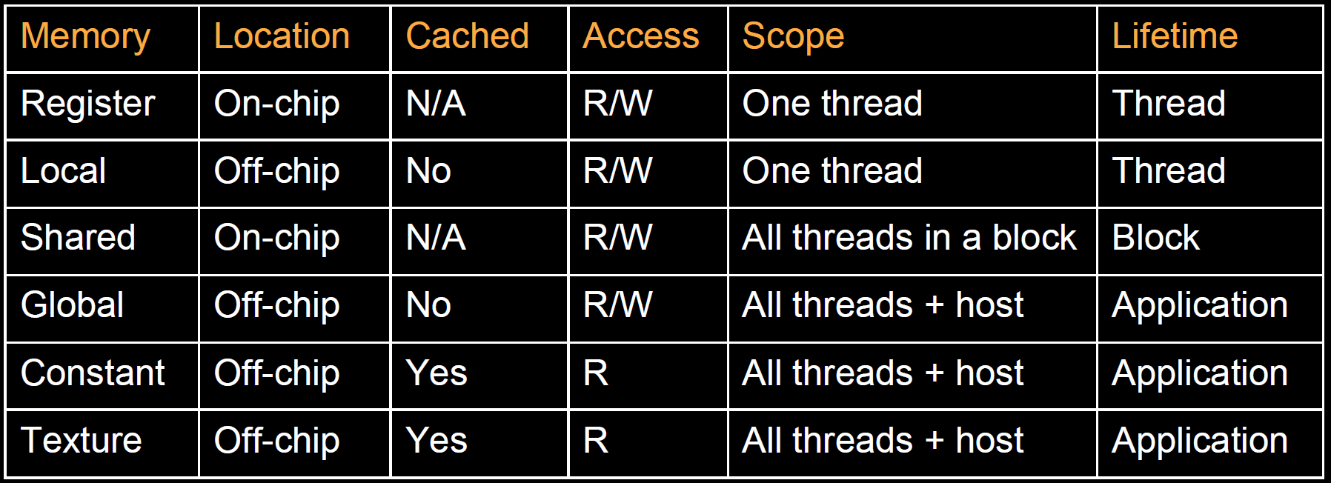

Slide 26
Task execution model
A group of N streaming processors execute in a lock-step basis, running the same program but on different data
Each instruction in the instruction queue is dispatched to every SP within an SM.
We have a huge register file, switching threads has effectively zero overhead
GPU supports a very high number of threads!

Slide 27
How to declare and call a kernel
Declare a kernel:
You simply put __global__ in the beginning of the prototype of a function!
The Nvidia compiler (nvcc) will know what to do
__global__ void mySuperKernel(float * A, float * B, float *C) { // here you can use blockIdx, threadIdx, etc..
[your parallel algorithm] }
Run a kernel:
You use the special operator <<< >>>
mySuperKernel <<<1, 1>>>(A, B, C); // executes 1 block composed of 1 thread (no parallelism)
mySuperKernel<<<B, 1>>>(A, B, C); // executes B blocks composed of 1 thread. Inter-SM parallelism
mySuperKernel<<<B, M>>>(A, B, C); // Executes B blocks composed of M threads each. Inter- and Intra- SM // parallelism

Slide 28
More on kernel invocation
Kernel_function<<<num_blocks, num_threads>>>(params…)
Use variables for num_blocks and num_threads, you are going to tune them.
num_threads is the number of threads in each block we want
The number of threads in a block are limited: 512, 1024, …
Parameters can be passed via registers or constant memory
If passed by registers: eg: 128 threads + 3 parameters : 128 x 3 = 384 registers
A GPU has a lot of registers, at least 8192 per SM. So potentially you could use 8192/128=64 registers per thread. But it is a bad idea: prefer using multiple blocks (otherwise the SM are going to be idle as soon as you access the memory)
The number of threads in a block should ALWAYS be a multiple of the warp size (32, 64, …)

Slide 29
More on kernel invocation – Shared memory
Dynamic
Kernel_function<<<num_blocks, num_threads, shared_memory_size * sizeof(int)>>>(params…)
__global__ void Kernel( params ) { extern __shared__ int a[]; }
Static
#define CONSTANT_SIZE 100
__global__ void Kernel( params ) { __shared__ int a[CONSTANT_SIZE]; }
See: https://stackoverflow.com/questions/5531247/allocating-shared-memory

Slide 30
Is 512 threads enough?
In the GPU world… NO
Take for eg: blurring a 1024 x 1024 image: 1048576 pixels
How to handle this?
Add more blocks (limit: 65 536 blocks!)
You have potentially 65 536 x 512 = 33 554 432 threads!
In reality, you will have up to three blocks per SM. This limit is based on the total number of threads per SM (1536 Fermi)
Currently the maximum number of SM is 30 in any card
Eg: if you schedule 65 536 blocks with 1024 threads each, you can process up to ~64 millions elements. Assuming each element is a single-precision floating-point number, requiring 4 bytes of data: you need around 256MB.
TODO: SEE EXAMPLE CODE PG 81

Slide 31
More on Blocks
A Kernel is executed in batches of 32 threads called warps
Threads are referenced according to 3D rectangular cuboid called a block with axes (x,y,z). At present, blocks are limited to a maximum 1024 threads. The maximum length of a block in the z direction is 64 threads and any of the axes for the block may have a length of 1 thread.

Slide 32
More on Grids
A grid is simply a set of blocks it’s like a 3D rectangular cuboid with axes x,y,z. The maximum number of blocks along a dimension is 65 536 and the minimum is 1
Eg: Image 1920 x 1080 pixels: 2 073 600 pixels
Lets say we want 192 threads -> 6 * 32 threads = 6 warps per block
This gives 10 blocks on each row of the image (192*10 = 1920)
Using a thread size that is a multiple of the X axis and the warp size makes life a lot easier
Total number of blocks needed: 1080 x 10 = 10 800 blocks
Find the number of blocks by SM : (fermi 8/SM)
How many SM needed -> #blocks/#blocks_by_SM = 10800/8 = 1350 SM)
Find how many SM we have (Fermi 16 SM)
Find how many blocks will be used by SM -> #blocks/#SM = 10800/16 = 675 blocks/SM

Slide 33
Mapping order
The order of threads in blocks and the order of blocks in grids are both arranged according to a FORTRAN-style column-major format.
The way you arrange the data in memory is independently on how you would configure the threads of your kernel.
The memory is always a 1D continuous space of bytes. However, the access pattern depends on how you are interpreting your data and also how you are accessing them by 1D, 2D and 3D blocks of threads.
dim3 is an integer vector type based on uint3 that is used to specify dimensions. When defining a variable of type dim3, any component left unspecified is initialized to 1.
dim3 blockdim(x,y,z);

Slide 34
Handling arbitrary vector sizes
Typical problems are not friendly multiples of blockDim.x. We have to prevent accessing beyond the end of arrays:
And now, update the kernel launch to include the “incomplete” block of threads:
mySuperKernel<<<(N + M-1)/256, 256>>>(A,B,C, N);
Number of threads/block = 256
Number of blocks = (N + M-1)/256 = (numberOfElements + NumberOfThreads-1)/NumberOfThreads = (N + 255)/256 blocks
__global__ void addKernel(int *c, const int *a, const int *b) { int i = threadIdx.x; c[i] = a[i] + b[i]; } addKernel<<<1, size>>>>(d_c, d_a, d_b);
__global__ void addKernel(int *c, const int *a, const int *b) { int i = threadIdx.x; if (i < size) c[i] = a[i] + b[i]; } addKernel<<< (size + (N-1))/N, N >>> (d_c, d_a, d_b);

Slide 35
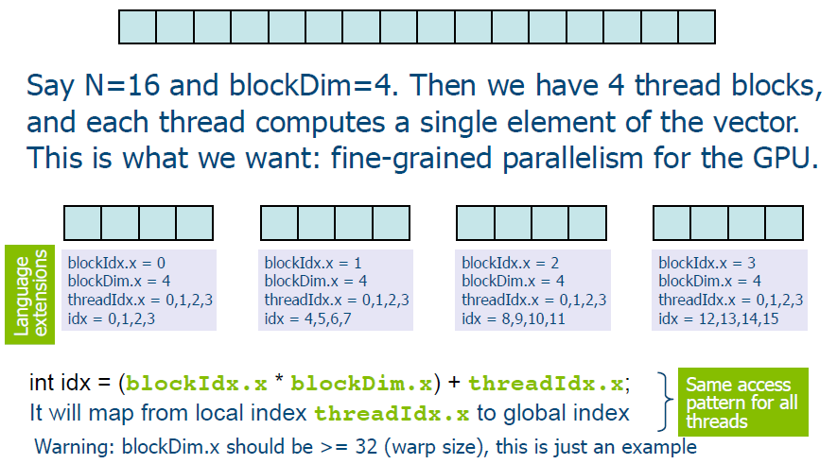
A first example: increment a vector
void increment_cpu(float *a, float b, int N) { for (int idx = 0; idx < N; idx++) a[idx] = a[idx] + b; }
void main() { …; increment_cpu(a, b, N); }
__global__ void increment_gpu(float *a, float b) { int idx = blockIdx.x * blockDim.x + threadIdx.x; a[idx] = a[idx] + b; }
Void main() {
int N = 16; dim2 blockDim(4,0); unsigned int numBytes = N * sizeof(float); float * h_a = (float*) malloc(numBytes); float * d_a = 0; cudaMalloc(&d_A, numBytes); cudaMemcpy(d_A, h_A, numBytes, cudaMemcpyHostToDevice); increment_gpu<<<N/blockSize, blockSize>>>(a, b);
cudaFree(d_A); }
__global__ void increment_gpu(float *a, float b, int N) { int idx = blockIdx.x * blockDim.x + threadIdx.x; if (idx < N) a[idx] = a[idx] + b; }
Void main() { …; dim3 dimBlock(blocksize); dim3 dimGrid(ceil(N/(float)blockSize)); increment_gpu<<<dimGrid, dimBlock>>>(a, b, N); }

Slide 36
Steps for building the CUDA source code
Identify the parts with a good potential to run in parallel exploiting SIMD data parallelism
Identify all data needed for the computations
Move data to the GPU
Call to the computational kernel
Establish the required CPU-GPU synchronization
Transfer results from GPU back to CPU
Integrate the GPU results into CPU variables

Slide 37
Coordinated efforts in parallel
Parallelism is given by block and threads
Threads within each block may require an explicit synchronization, as only within a warp it is guaranteed its joint evolution (SIMD):
a[i] = b[i] + 7; _syncthreads(); x[i] = a[i-1]; // the warp 1 reads here the value of a[31] which should have been written by warp 0 before
Kernel borders place implicit barriers:
Kernel1 <<<nblocks, nthreads>>> (a, b, c);
Kernel2 <<<nblocks, nthreads>>> (a,b);
Blocks can coordinate using atomic operations:
Eg: Increment a counter “atomicInc();”

Slide 38
Why do we need threads?
Threads add a level of complexity without contributing with new features.
However, unlike parallel blocks, threads can:
Communicate (via shared memory)
Synchronize (for example, to preserve data dependencies)
We can share data between threads by using shared memory within the block
Shared memory is user-managed: declare with __shared__ prefix in a kernel
Data is allocated per block
Shared memory is extremely fast (500x faster than global memory)
Shared memory is more versatile than registers (registers are private to each thread)

Slide 39
Limits of the shared memory and registers
Kepler: max of 64K registers and 48Kb of shared memory per SM
2 blocks per SM: max 32K registers, 24Kbytes of shared memory
3 blocks per SM: max 21,3K registers and 16Kbytes of shared memory
4 blocks per SM: max 16 K registers and 12Kbytes of shared memory
You can find on internet the « CUDA Occupancy Calculator » to figure out the limits!
More on the shared memory on the next exercise session!

Slide 40
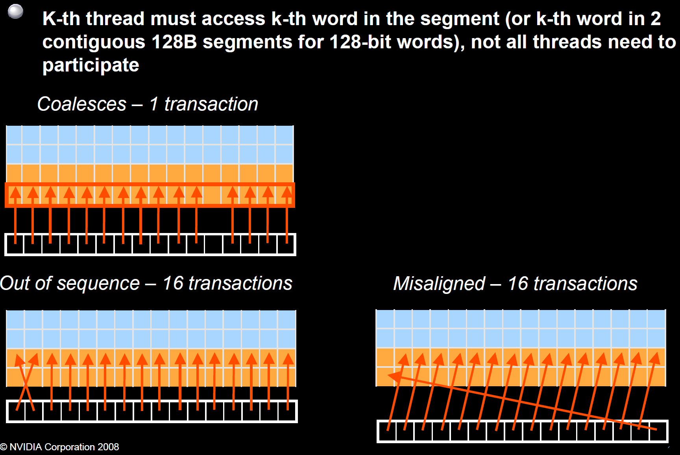
Coalescence

Slide 41
Divergences
Control Flow Divergences
Avoid divergences (conditionals where threads in a warp do different things)
Data Address Divergences
Hardware is optimized for accessing contiguous blocks of global memory when performing loads and stores.
Global memoy blocks are aligned to multiples of 32, 64, 128 bytes
If requests from a warp span multiple data blocks, multiple data blocks will be fetched from memory.
Entire block is fetched even if only a single byte is accessed, which can waste bandwidth
Hardware may need to issue multiple loads and stores whan a warp accesses addresses that are far apart

Slide 42
Occupancy
Maximize the arithmetic intensity
Math/memory
You want to maximize the compute operations per thread
Every thread are working
Avoid divergences
Every thread terminate at approximatively the same time
Or
You want to minimize the time spent on memory per thread
Memory coalescing, spatial, temporal optimizations, etc..

Slide 43
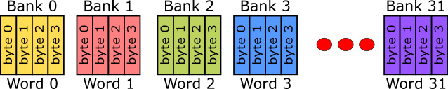
Bank Conflicts
To achieve high bandwidth, shared memory is divided into equally-sized memory modules, called memory banks
Each bank can only address one dataset at a time
Bank conflicts arise because of some specific access patterns of data
We have 32 banks in the shared memory*
Everything is split in words (4bytes) int (32 bits), float, half double, …
word[0] is in bank 0 word[1] is in bank 1 …
*The programming guide indicates 16 banks for compute capability 1.x, and 32 banks for compute capability 2.x and 3.x.

Slide 44
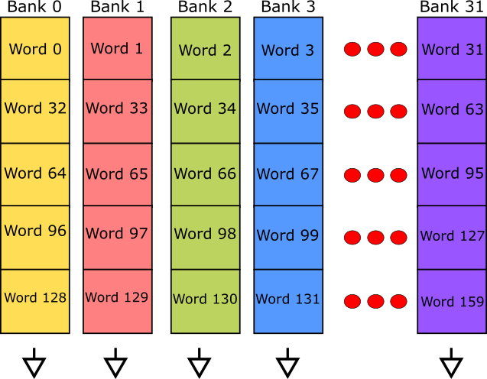
Bank Conflicts
If the threads of a warp all request the same word, we have a broadcast
If several threads request the same value from a particular bank, we have a multicast
Eg:
5 threads reading bank 2 word 2
5 threads reading bank 30 word 30
Same word for each 5 threads
The moment two or more threads reads different words from the same bank, we have a bank conflict

Slide 45
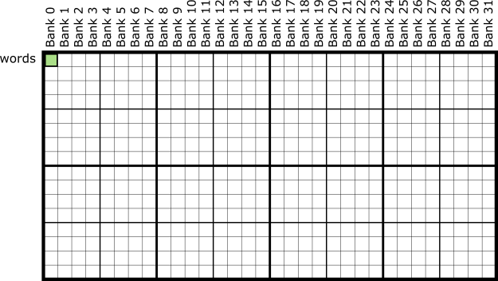
Bank Conflicts - Patterns
Broadcast: Every expression which results in a single value for all threds in each warp
arr[threadIdx.x*0]
arr[12]
arr[blockIdx.x*3]

Slide 46
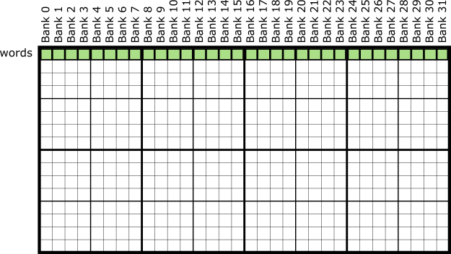
Bank Conflicts - Patterns
Each thread requests a word based on its threadIdx
arr[threadIdx.x]
Each bank is only accessed for a single value

Slide 47
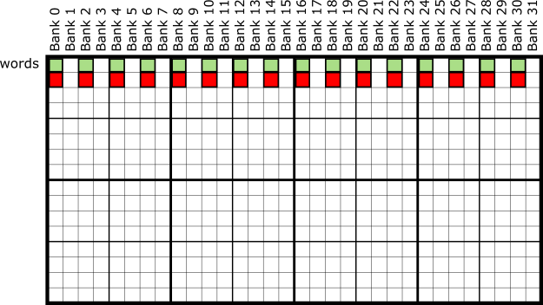
Bank Conflicts - Patterns
Threads of a warp request words which are double of their threadIdx
We are working with doubles, structures of 2 floats, 8 bytes data, …
arr[threadIdx.x*2]
We have a 2way bank conflict! (twice as slow!)

Slide 48

Bank Conflicts - Patterns
When we are working with 12 bytes data (eg: Spatial points X,Y,Z, floats)
We don’t have bank conflicts!
So when we use doubles we can add an extra padding to avoid bank conflicts!
! This is not always the case, on some architectures, doubles are as fast as this!

Slide 49
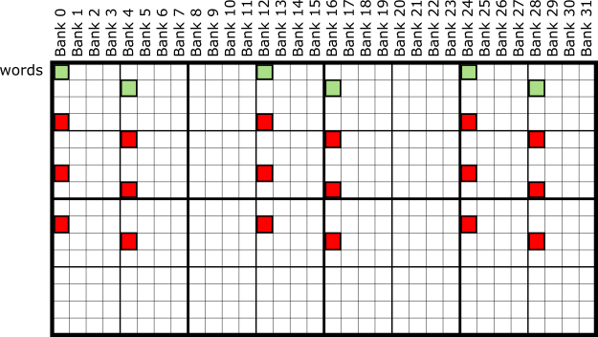
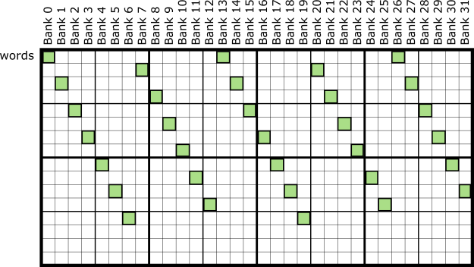
Bank Conflicts - Patterns
4 way bank conflicts – With 12 bytes apart
arr[threadIdx.x*12]
We can solve this by adding a pad of 1

Slide 50
Bank Conflicts – Final words
Latency hiding
Even with bank conflicts, if many threads are running on a SM, the scheduler can simply switch to another warp while the bank figure out the requested data.
The only real way to know if bank conflicts are slowing an algorithm is to experiment with padding and access patterns.

Slide 51
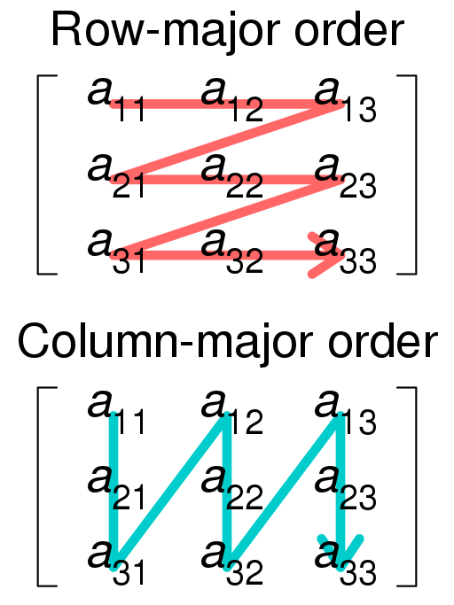
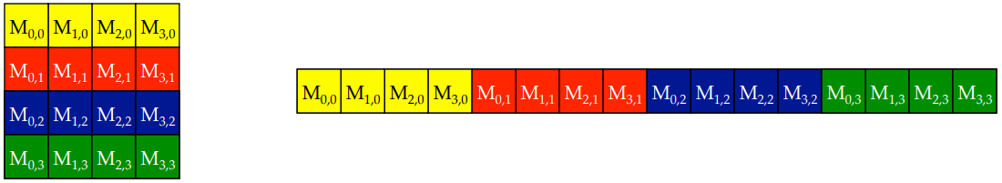
Appendix: Row-major vs Column-major
Row major order
Generally we cannot use two-dimensional indices A[row][column] to access matrices in GPU
We will need to know how the matrix is laid out in memory and then compute the distance from the beginning of the matrix
Eg
int x = blockIdx.x * blockDim.x + threadIdx.x; int y = blockIdx.y * blockDim.y + threadIdx.y;
int linear_index_col_major = x + y * ROW_SIZE;
int linear_index_row_major = y + x * COL_SIZE;

Slide 52
Appendix: Rules of thumb
Prefer thread block sizes that result in mostly full warps
Bad: kernel<<<N, 1>>> ( ... )
Okay: kernel<<<N/32, 32>>> ( ... )
Better: kernel<<<N/128, 128>>>(…)
Prefer to have enough threads per block to provide hardware with many warps to switch between
When number of threads is not a multiple of preferred block size, insert bounds test into kernel
__global__ void kn(int n, int* x) { int i = threadIdx.x + blockDim.x * blockIdx.x; if ( i < n) { [CODE] } }

